Slide 1


NAME OF THE PROJECT: A Power Point Presentation on:
Submitted by:
A KISHORE KUMAR
Batch No.:
Internship_33

Slide 2
INTRODUCTION:
For a long history of several decades, Black Friday has been recognized as the largest shopping day of the year in the US. It is the Friday after Thanksgiving and for American consumers, it ignites the Christmas holiday shopping.
On Black Friday big shopping giants like Amazon, Flipkart, etc. lure customers by offering discounts and deals on different product categories. The product categories range from electronic items, Clothing, kitchen appliances, Décor.
For most retailers, it is the busiest day of the year. Sales are so high for Black Friday that it has become a crucial day for stores
Research has been carried out to predict sales by various researchers. The analysis of this data serves as a basis to provide discounts on various product items. With the purpose of analyzing the sales.

Slide 3
Problem Statement:
A retail company “ABC Private Limited” wants to understand the customer purchase behavior (specifically, purchase amount) against various products of different categories.
The data set also contains customer demographics (age, gender, marital status, city_type, stay_in_current_city), product details (product_id and product category) and Total purchase_amount from last month.
Now, they want to build a model to predict the purchase amount of customer against various products which will help them to create personalized offer for customers against different products.
The Black Friday Sales dataset is used for training various machine learning models and also for predicting the purchase amount of customers on black Friday sales .
The purchase prediction made will provide an insight to retailers to analyze and personalize offers for more customer's preferred products.

Slide 4
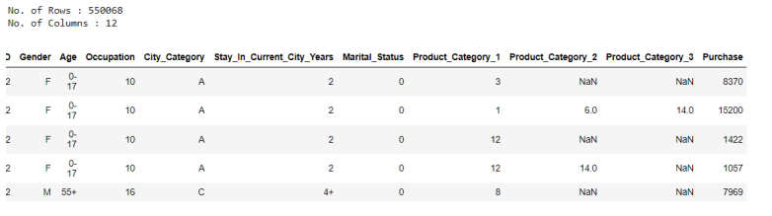
Data Sources and their formats:
Data set provided by Flip Robo was in the format of CSV (Comma Separated Values).
There are 2 data sets that are given. One is training data and one is testing data.
Train file will be used for training the model, i.e., the model will learn from this file. It contains all the independent variables and the target variable. The dimension of data is 5,50,068 rows and 12 columns.
Test file contains all the independent variables, but not the target variable. We will apply the model to predict the target variable for the test data. The dimension of data is 2,33,600 rows and 12 columns.

Slide 5
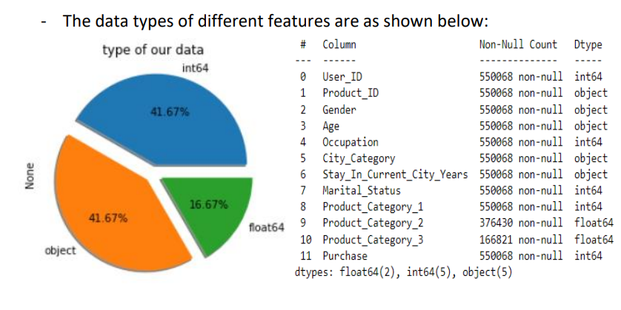
Dataset Information:
• Dataset consist of two CSV files, one for training model & other for testing dataset.
• Training dataset contain 550068 Rows & 12 Columns.
• There can be some missing values that are present in the dataset. With which we'll have to deal.
• We can drop 'User_ID','Product_ID', because we want to be able to predict the buying behavior of any customer, not just those who are already recorded in the dataset.

Slide 6
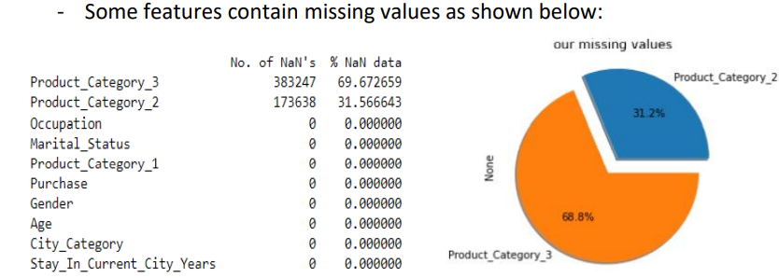
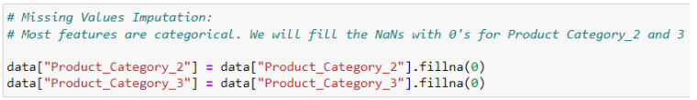

Slide 7
Observations:
Dataset contains both Object & Numerical data types.
Dataset contains numerical as well as categorical variables.
It would make sense to look at the summary statistics of the purchase variable. We see that the average purchase amount is 9263.97. The remainder of the variables don't make much sense to check summary statistics, as they are categories. Nevertheless, we have included them but won't examine them for insight.
The dataset contains many null values in Product_Category_3 & Product_Category_2 coumns.
It makes sense for there to be missing values because some customers might only buy one category of product and not buy from the other 2 product categories. We should fill the missing value with a 0 to show this.

Slide 8
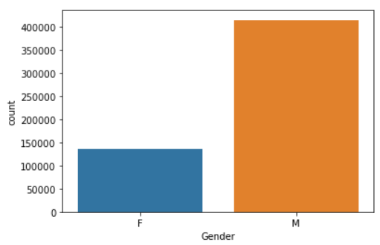
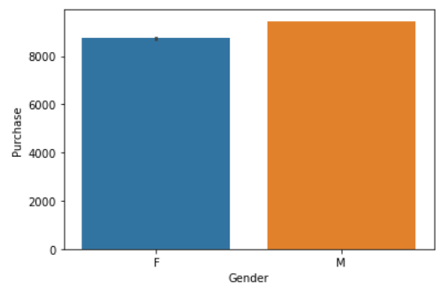
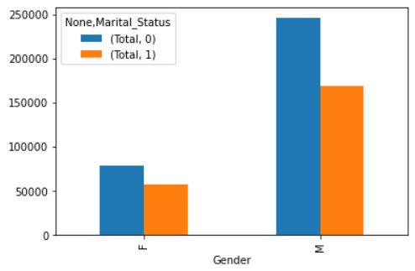
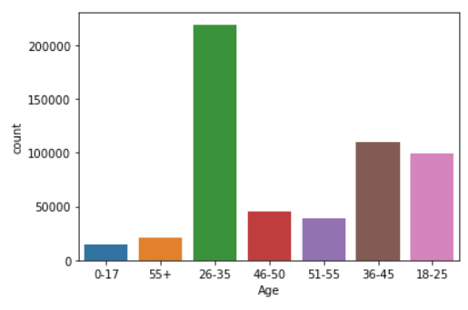
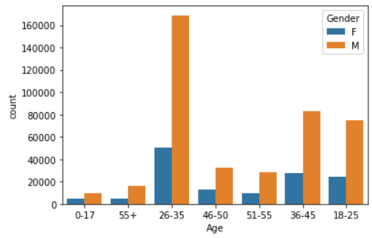
Exploratory Data Analysis (EDA)
The count plots for different attributes are visualized as different figures are shown above.

Slide 9
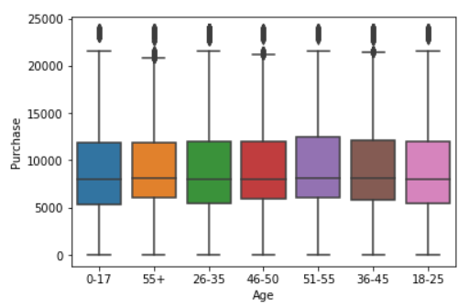
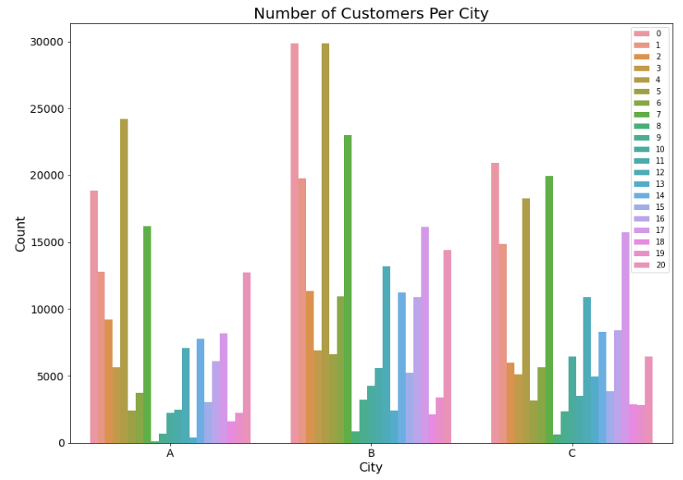
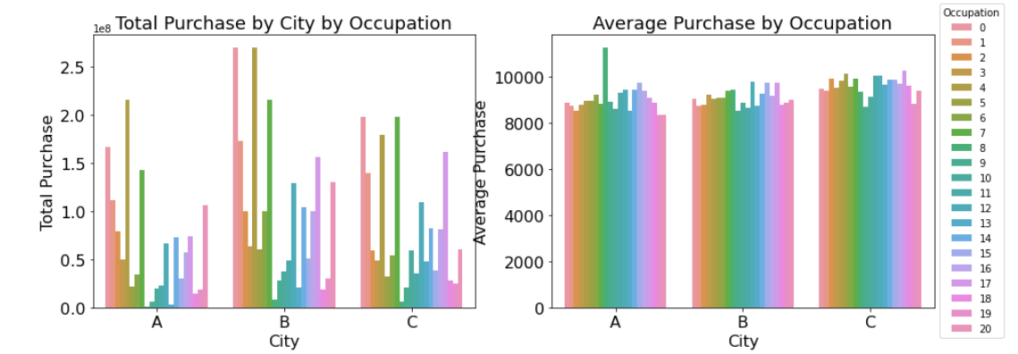

Slide 10
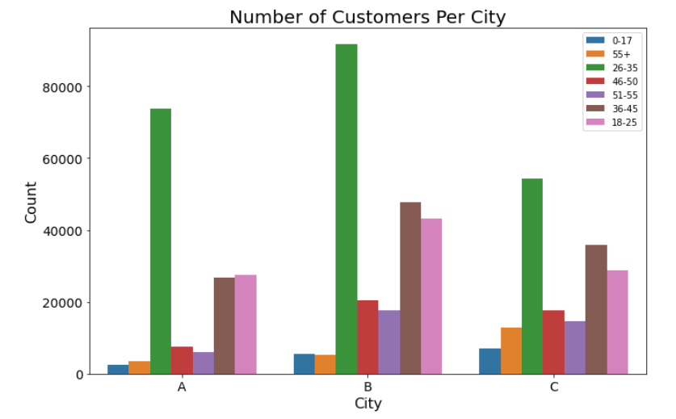
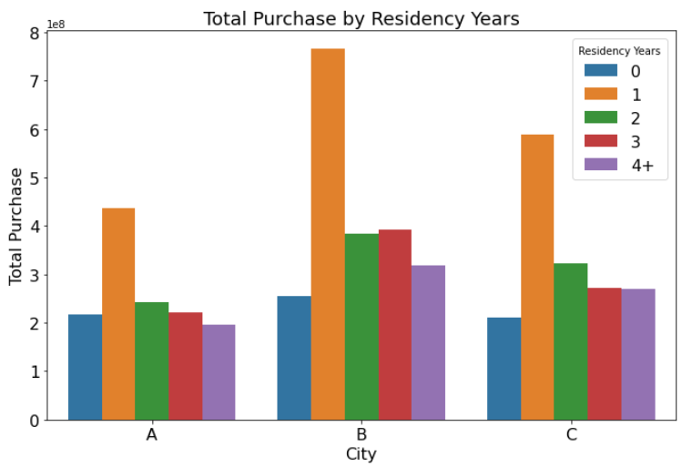
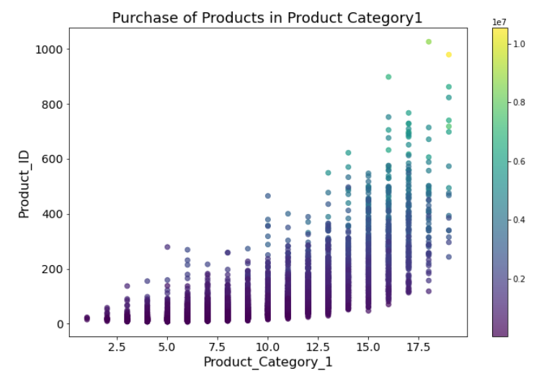

Slide 11
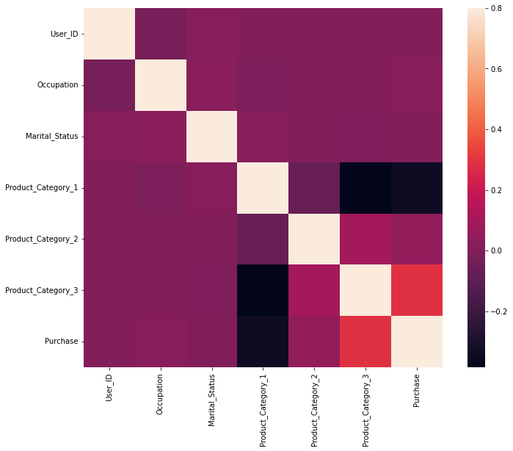
- Heatmap is used for determining the correlation between dataset attributes.
- It uses a color system to represent the correlation among different attributes.
- Variables correlated with Purchase:
Product_Category_3 (positive correlation)
Product_Category_1 (negative correlation)
- Perhaps Product_category 3 is positively correlated because it offered cheaper products. So, let's see if this is true by checking the average price of the product categories.

Slide 12
CONCLUSION
The key purpose of this study is to investigate the Exploratory Data Analysis (EDA) techniques in extremely noise data. More specifically, the current results have confirmed the effective strategy to predict the amount of purpose. The Black Friday challenge is still operating, so much further consideration can be made to improve the result. This project strongly indicates the need of more advanced model's tuning and feature engineering.

Slide 13


